Slide 1
Annual Conference 2025
Sponsorship and exhibition opportunities
Emma Madray, events manager
May 2025

Slide 2
About the Electricity Storage Network
Established in 2008 and managed by Regen since 2018, the Electricity Storage Network is the only industry body dedicated to grid-scale storage in GB. Together with our 100 members and 600 industry professionals, we are shaping policy, regulation and market reform to unlock the full potential of storage technologies.
Amplify your voice.
Expand your network.
Keep ahead of policy changes.
ESN sponsor members:

Slide 3
Annual Conference 2025
Now in its seventh year with Regen, the Electricity Storage Network Annual Conference is a platform for key industry players and policymakers to gather and debate what’s needed to attract and maintain the billions of pounds of investment required for this crucial asset class.
Gold sponsor 2025
300+ attendees
Opportunity for key industry players and policymakers to gather
Speakers from Department for Energy Security and Net Zero, Ofgem and the National Energy System Operator
Updates on latest changes across a range of topics critical to the storage sector, including Clean Power 2030, revenue models, long duration energy storage, grid connection reform and fire safety
Opportunity to learn about ESN’s work to ensure policy, markets and regulation are geared to enable the storage sector to flourish and grow at the pace and scale required.
Typically represented companies

Slide 5
Sponsorship and exhibition opportunities
Sponsoring and exhibiting at the ESN Annual Conference offers numerous strategic advantages for companies in the energy sector to raise your profile:
🤝 Engage with key industry leaders and expand your network
The ESN Annual Conference attracts hundreds of industry professionals, including policymakers from the Department for Energy Security and Net Zero, Ofgem and the National Energy System Operator. This is an unparalleled opportunity to engage with decision makers and use this intel to shape your business strategy.
📣 Showcase your work
Electricity storage is pivotal to a zero-carbon energy system, the conference serves as a platform to present your latest technologies and solutions to a targeted audience of stakeholders and potential partners.
💼 Enhance brand visibility
Position your company as a leader in the energy sector and increase your brand's visibility among key stakeholders and potential clients.
📊 Gain insights into market trends
Participate in discussions on evolving business models, regulatory changes and investment strategies essential for the growth of the storage sector. Stay ahead of industry trends and adapt your strategies accordingly.

Slide 6
Headline sponsor package
£25,000/£30,000 (member/non-member price +VAT)
Exclusive opportunity to be the headline sponsor with premium branding, alongside ESN, at the venue (at the entrance, in the room and on all event materials). This will not be offered to any other company, to ensure exclusivity and maximum impact.
Opportunity to input into the agenda and explore ways to maximise profile, including in social content ahead of the event.
Opportunity for a sponsor's welcome at the event.
Prominent exhibition space at the event (3m x 2m stand options and 1m pop-up).
Five delegate passes for the in-person conference.
Plus all the elements included in gold sponsorship (see next slide).

Slide 7
Sponsorship opportunities (Member/non-member price +VAT)
Gold – £15,000/£18,000
Opportunity to input into the agenda and explore ways to maximise profile
Company highlighted as a sponsor on all event presentations used in the conference
Company listed as a sponsor on the event website, including organisation profile and a direct link to a chosen webpage
Three delegate passes for the in-person conference
Enhanced branding during the in-person conference
Increased prominence on all event promotion, market material and content
Exhibition space (3m x 2m and 1m pop-ups).
Silver – £10,000/£12,000
Enhanced branding during the in-person conference
Company highlighted as a sponsor on all event presentations used at the conference
Company listed as a sponsor on the event website, including organisation profile and a direct link to a chosen webpage
Three delegate passes for the in-person conference
Listed as a sponsor on all key marketing material ahead of the event
Opportunity to explore session sponsorship (i.e. fireside chat)
Space for a 1m pop-up banner.
*upgrade to include 3mx2m exhibition space +£2,000
Bronze – £6,000/£8,000
Company listed as a sponsor on the event website, including organisation profile and a direct link to a chosen webpage
Company highlighted as a sponsor on all event presentations used in the conference.
Listed as a sponsor on all the key marketing material ahead of the event
Two delegate passes for the in-person conference
Space for a 1m pop-up banner.
*upgrade to include 3mx2m exhibition space +£2,000

Slide 8
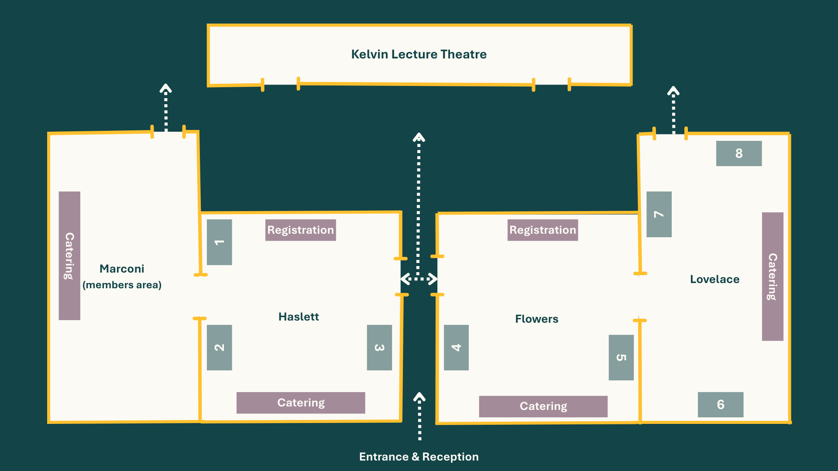
Exhibition opportunities £4,000/£5,000 (member/non-member price) +VAT 3m x 2m exhibition space, eight stands available – includes two tickets to attend the conference.
See stand locations numbered in the diagram – these will be allocated on first-come-first-served basis.

Slide 9
Interested?
Get in touch to tailor these packages to your needs:
Olly Frankland ofrankland@regen.co.uk
Emma Madray emadray@regen.co.uk

